Slide 1
CASE STUDY
LENDING CLUB
TOPIC: LOAN REQUESTS
GROUP FACILITATOR NAME:
GITHUB:
TEAM MEMBERS: SAJAL TIWARI & SHYAM PRASAD SHUKLA
BATCH: JULY

Slide 2
TARGET
VARIABLE

Slide 3
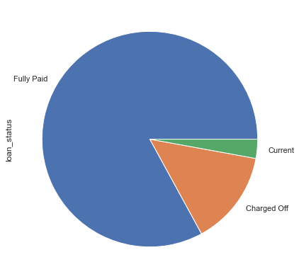
Target Variable (Original)
Column: loan_status
Description: Current status of the loan

Slide 4
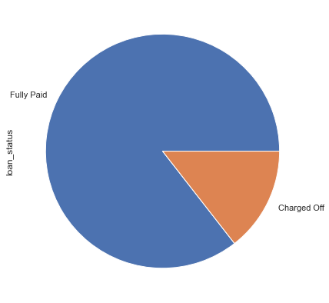
Target Variable (Transformed)
Recommendation Values:
Fully paid.
Charged off.

Slide 5
FEATURE
VARIABLE
SELECTION

Slide 6
Insights on Feature Selection
Method:
High variation between lowest and highest proportion percentage for ‘charged off’ situations.
Have linear relationship or identifiable relationship with Default rate.
Features:
Sub grade.
Interest rate
Public recorded bankruptcies.
Purpose.
term.

Slide 7
Sub Grades

Slide 8
Information
Column: sub_grade
Description: LC assigned loan subgrade

Slide 9
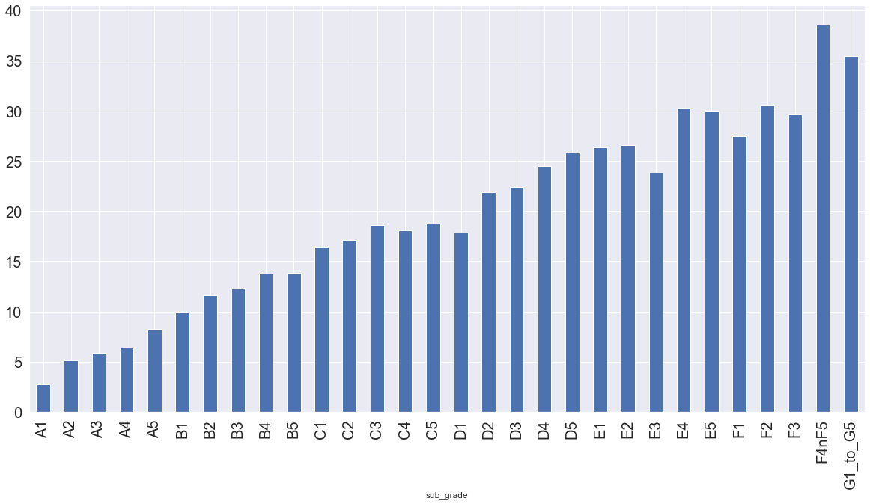
Sub grades

Slide 10
Analysis
observation
default chances more with higher grades.
all sub grades with 'F' and 'G' have almost 40% default chances.
recommendation
if sub-grade assigned while reviewing loans is higher, reject loan requests.

Slide 11
Interest Rate

Slide 12
Information
Column: int_rate
Description: Interest Rate on the loan.

Slide 13
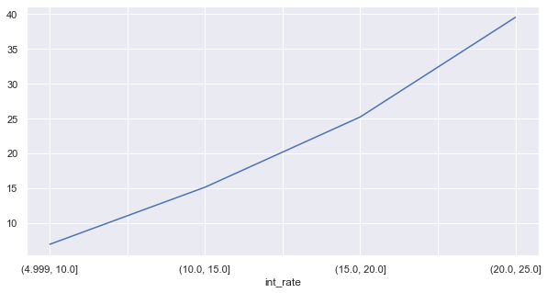
Graph

Slide 14
Analysis
observation
default chances increases with interest rate.
recommendation
customer taking loans at higher interest may default easily, approve loans only at low loan amount.

Slide 15
Public Recorded Bankruptcies

Slide 16
Information
Column: pub_rec_bankruptcies
Description: Number of public record bankruptcies

Slide 17
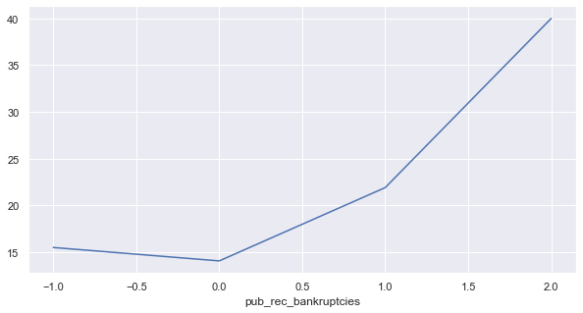
Graph

Slide 18
Sub grades
observation
default chances more with higher grades.
all sub grades with 'F' and 'G' have almost 40% default chances.
recommendation
if sub-grade assigned while reviewing loans is higher, reject loan requests.

Slide 19
Purpose

Slide 20
Information
Column: purpose
Description: A category provided by the borrower for the loan request.

Slide 21
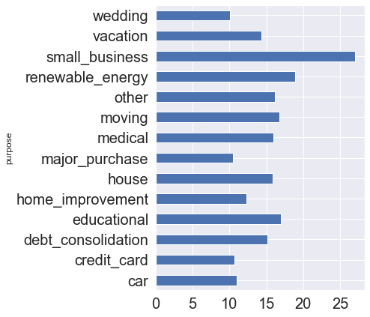
Graph

Slide 22
Analysis
observation
default chances more with selected purpose of loan request
recommendation
take precautions for loan requests for specific purpose:
small business : take necessary precautions and follow certain protocols.
renewable energy : reject loans or assess project
vacation : approve loans of small amount.
education : check institute and course information before approving loan.
debt consolidation : approve only small amount loans.
house : check property value resale before approving loans.

Slide 23
Term

Slide 24
Information
Column: term
Description: The number of payments on the loan. Values are in months and can be either 36 or 60.

Slide 25
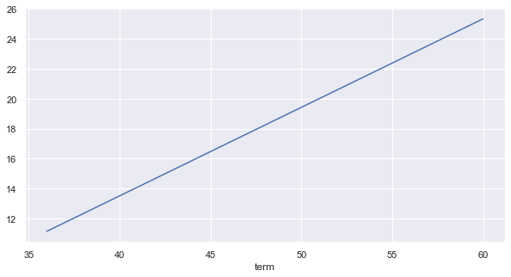
Graph

Slide 26
Description
observation
default more with 60 month term.
recommendation
approve loans mostly for 36 months.

